Slide 1
Proposed bond Projects
Board Study Session: April 29, 2017
Presented by: Ambelina Garcia Duran

Slide 2
Potential Funding
New Bond
  Bond proceeds $20,000,000
State School Building Program
  Horizon Elementary School $ 7,976,236
  High School Modernization $ 1,500,264
    Total $ 9,476,500
  Reserved for DO Remodel $ 4,000,000
    Adjusted Total $ 5,476,264
District Funds
  Fund 21 $ 340,417
  Fund 25 $ 573,362
  Fund 40 $ 3,572,001
      Total $ 4,485,780
Total Potential Funding $29,962,044

Slide 3
Bond Project Proposal
Projects
  New Multi-Purpose Building (1000 capacity) $ 8,000,000
  New Two-Story 10 Classroom Building - MHS $ 5,200,000
  New Parking Lot and Outdoor Student Courtyard at MHS $ 1,500,000
  New Sports Complex at MMS $ 8,000,000
  Old Cafeteria Converted to New Weight/Wrestling Room $ 1,800,000
  New Two-Story 10 Classroom Building – MMS $ 5,300,000
      Total $29,800,000
Funding
  Bond $20,000,000
  State Reimbursement $ 5,476,264
  Fund 21,25, & 40 Committed Funds $ 4,485,780
      Total $29,962,044

Slide 4
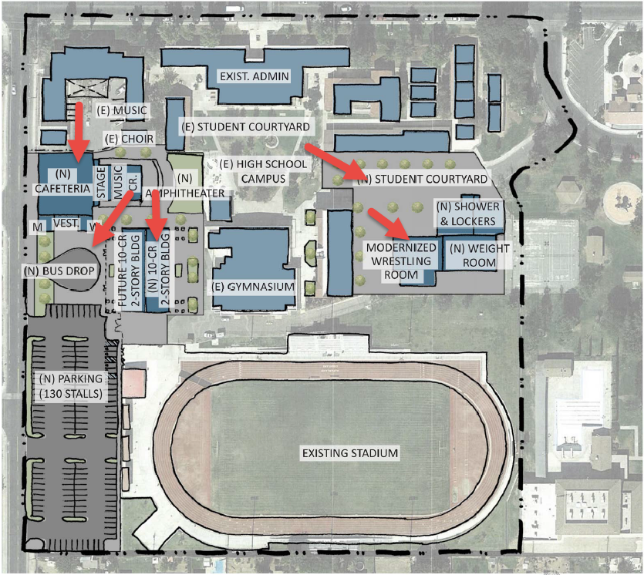
Bond Project Proposal

Slide 5
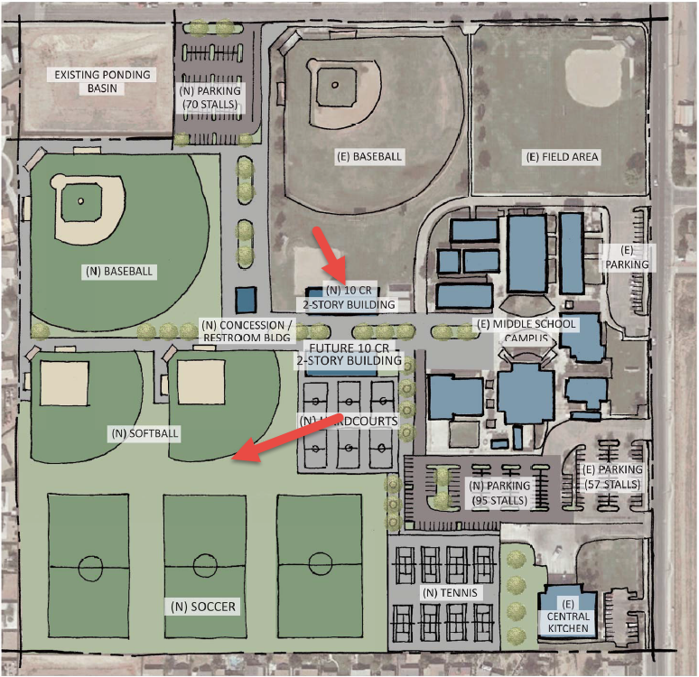
Bond Project Proposal

Slide 6
State Hardship Funding
Future Projects
  New Concession/Restroom Building $ 1,300,000
  New Weight Room Showers and Lockers $ 4,000,000
  Future Two-Story 10 Classroom Building – MMS $ 5,200,000
  Future Two-Story 10 Classroom Building – MHS $ 5,200,000
      Total $15,700,000
New Construction Eligibility Funding
  K-6 Grades $ 2,864,832
  7-8 Grades $ 1,503,232
  9-12 Grades $ 4,901,632
  SDC Non Severe $ 4,549,006
    Total $ 13,818,702

Slide 7
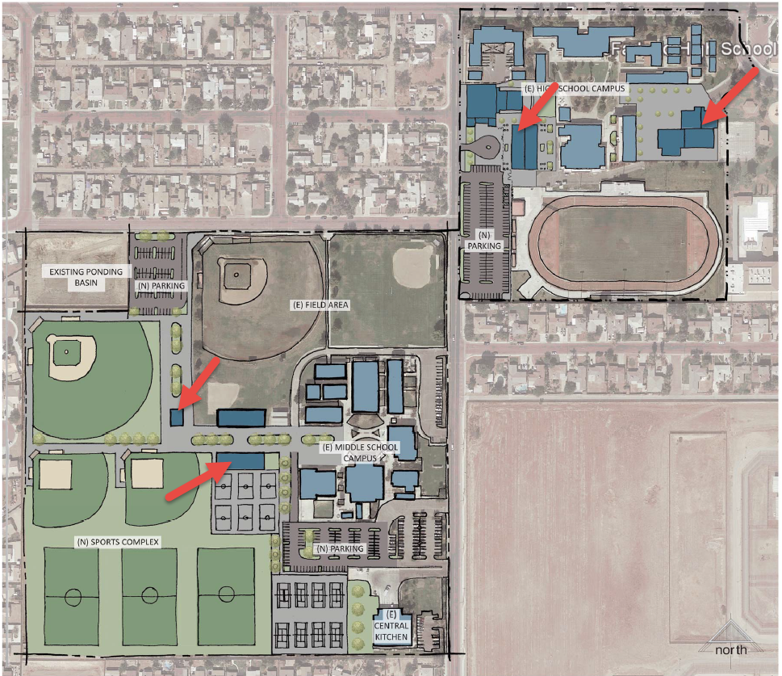
State Hardship Projects

Slide 8
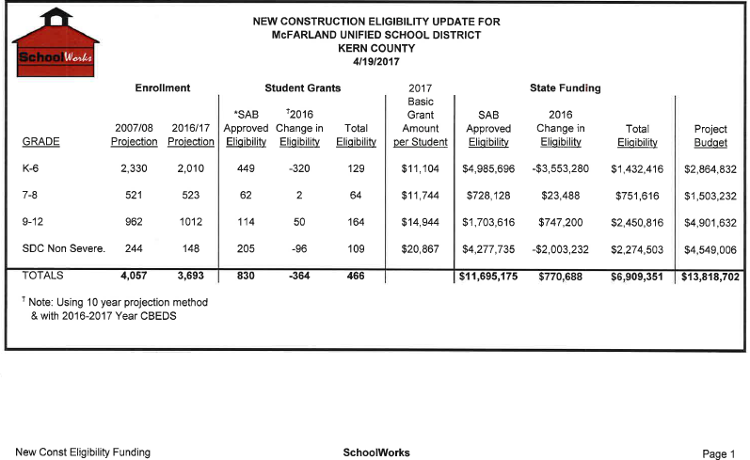
SchoolWorks Analysis

Slide 9
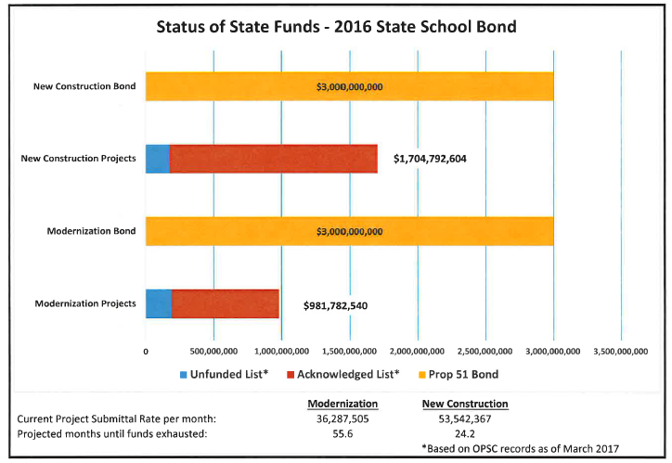
SchoolWorks Analysis

